Slide 1
Wind energy prediction using weather data

Slide 2
Team details
Team Avengers
Shreyash Nikam
Tejas phirke
Pratik sonkusale
Pranav Patki

Slide 3
Project description
Our web app will give the predictions on wind and solar energy using the weather data
It will also track and give the location of user when inputs are given
It uses machine learning linear regression algorithm which gives the predictions
User can easily give the weather inputs and get the corresponding values

Slide 4
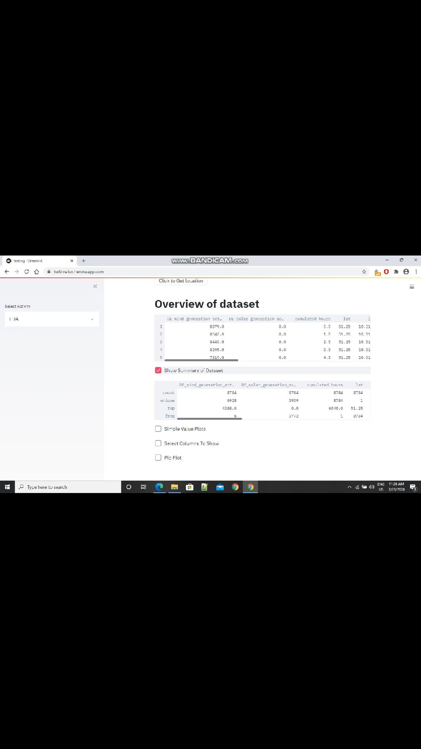
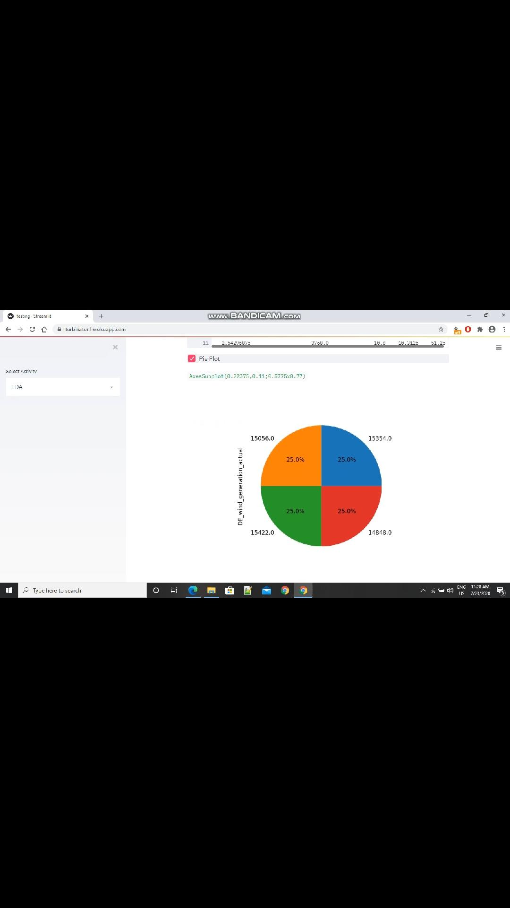
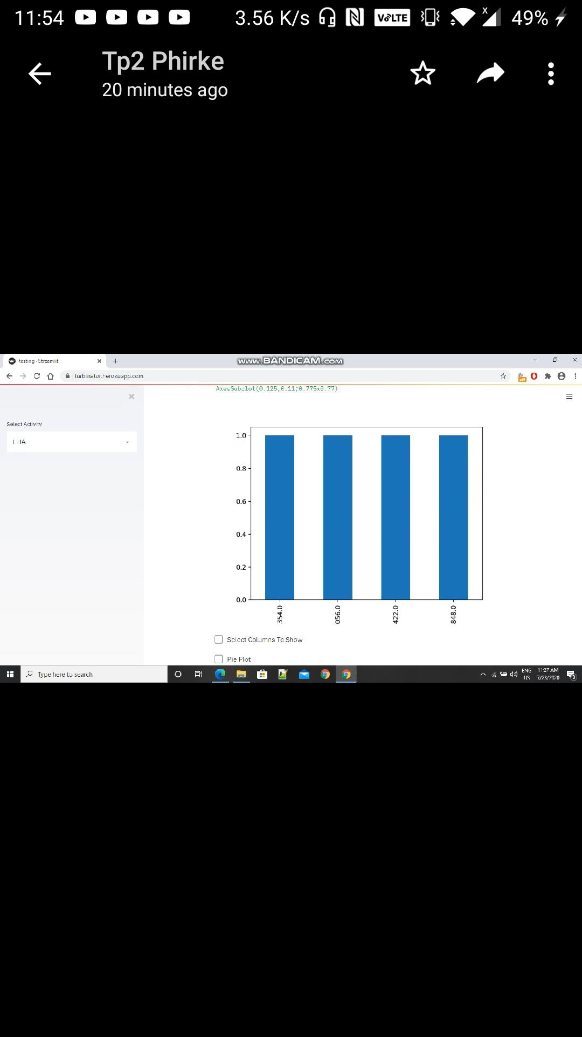
User interface of application
General description of data

Slide 5
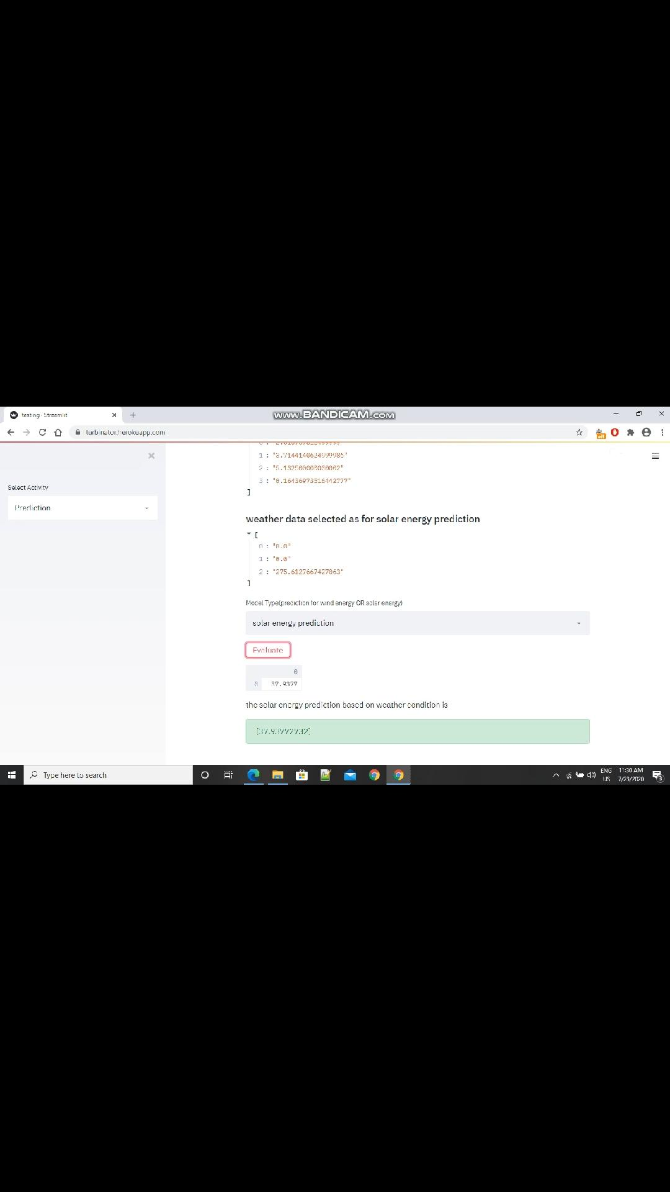
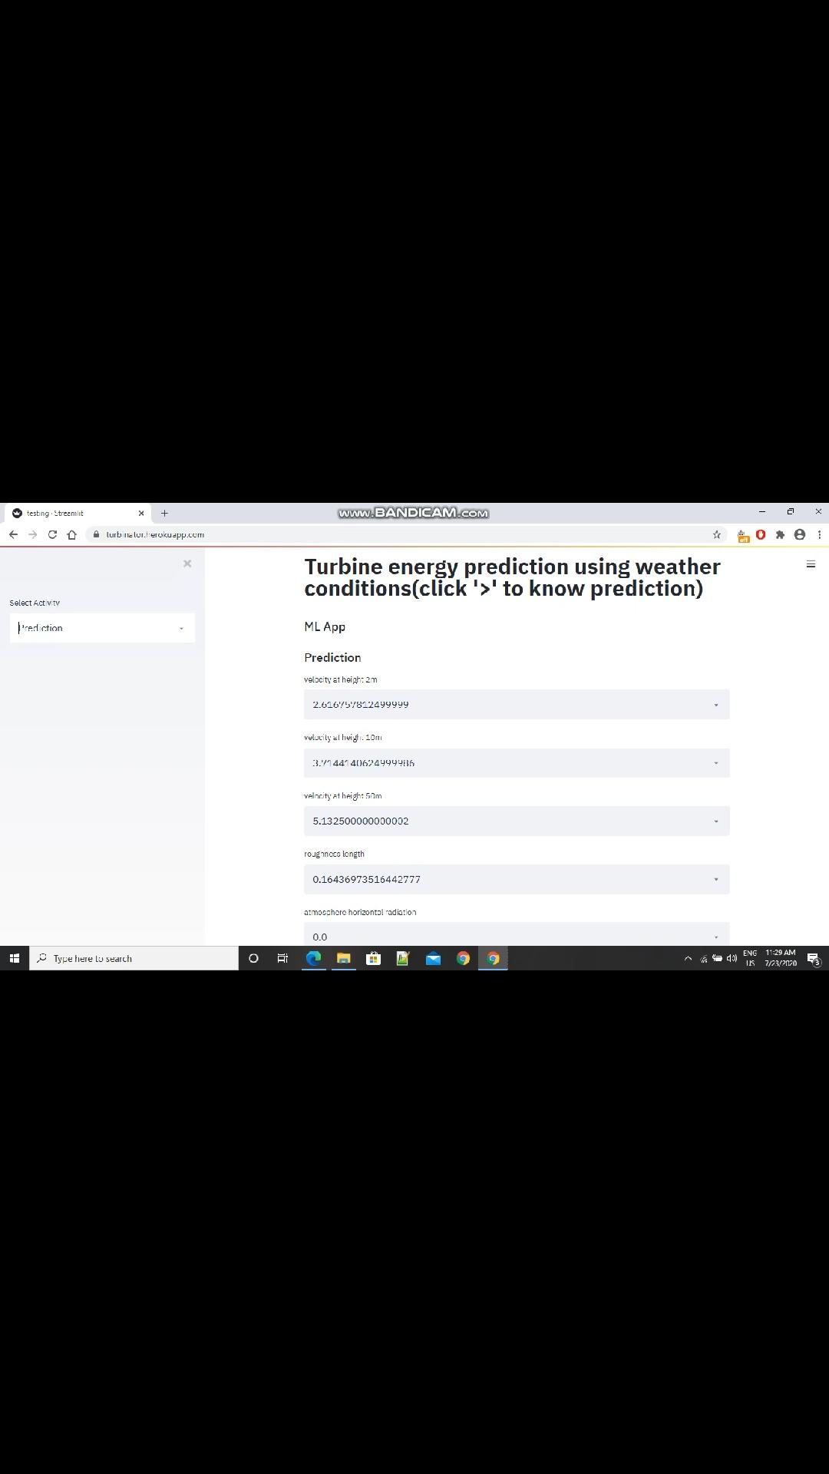
Predictions

Slide 6
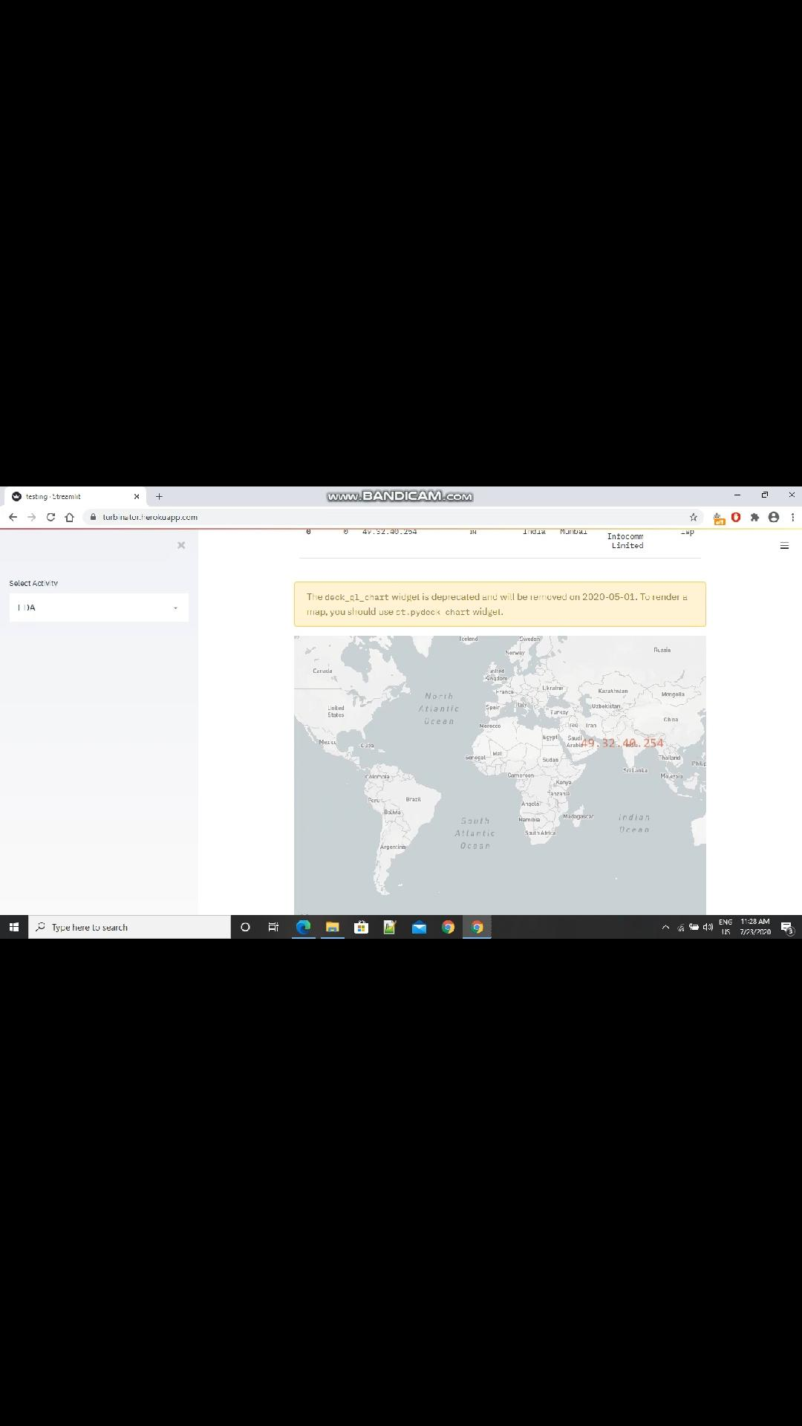
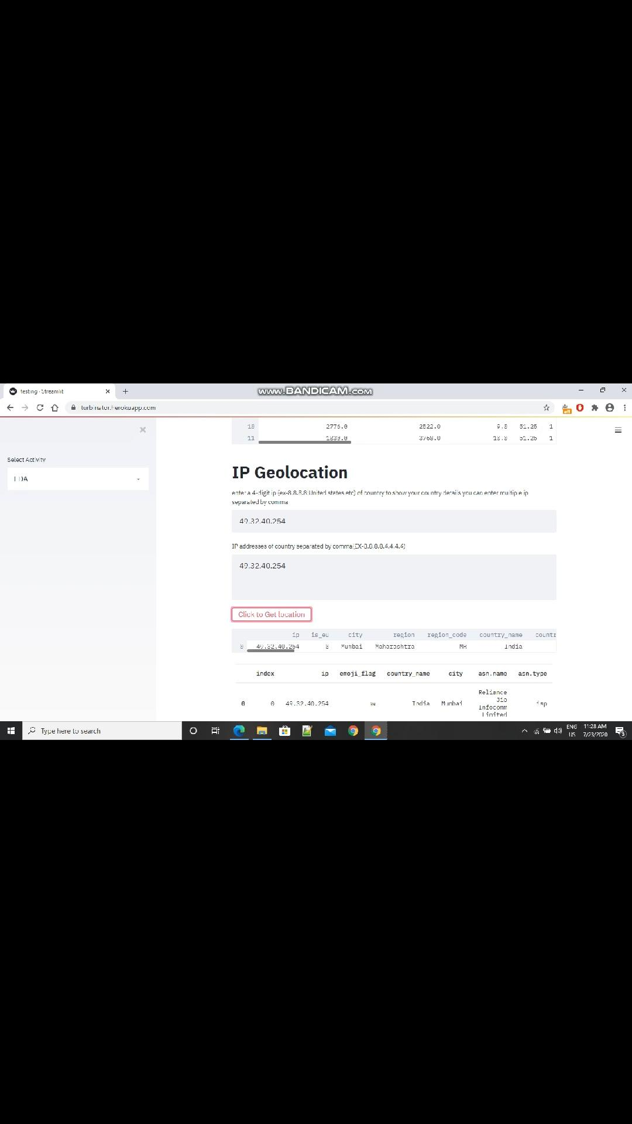
Geolocation

Slide 7
Technology used
Python libraries like pandas, numpy, matplotlib
Jupyter notebook
Streamlit
Heroku

Slide 8
Visit our app
Link
https://turbinator.herokuapp.com/

Slide 9
Thank you

